Slide 1

EMOTION RECOGNITION using TEXT
Presented By : P.R.V Prethikaa
(211422104353)
Guided by
Ms .Lincy Jemina
CSE Department

Slide 2
abstract
This project presents a novel strategy in the domain of emotion recognition from textual data, which is crucial for applications like mental health monitoring and customer service. By leveraging state-of-the-art deep learning and natural language processing techniques, a hybrid model is developed that integrates transformer architectures with traditional feature extraction methods. This model demonstrates significant improvements in both accuracy and the detection of nuanced emotional expressions across various scenarios compared to existing benchmarks. The results emphasize the importance of linguistic signals and contextual understanding, contributing to the development of empathetic AI systems capable of recognizing emotions in real time.

Slide 3
objective
This project seeks to develop a hybrid model for emotion recognition from textual data by combining transformer architectures with traditional feature extraction techniques. The goal is to enhance accuracy and sensitivity in detecting complex emotional expressions, making it valuable for real-time applications like mental health monitoring and customer service. By leveraging deep learning and natural language processing, the model will utilize linguistic cues and contextual information to create more empathetic AI systems. This approach will contribute to improving AI's ability to understand and respond to human emotions, leading to more effective and emotionally intelligent artificial intelligence solutions.

Slide 4
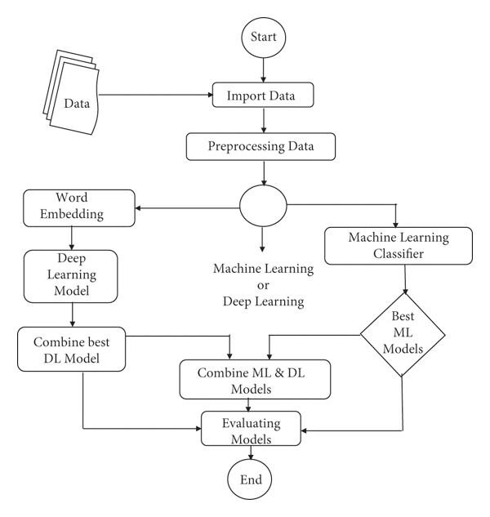
ARCHITECTURE

Slide 5
This Architecture diagram illustrates a system that analyzes text input to identify emotions. It begins with text input, followed by preprocessing (tokenization and normalization). Next, feature extraction employs NLP techniques and word embeddings to convert text into numerical representations. These features are fed into an emotion recognition model, leveraging machine learning or deep learning algorithms. The model classifies emotions and outputs sentiment analysis or emotion detection results. Key components include data sources, preprocessing, feature extraction, emotion recognition models, and output. Technologies utilized may include NLP libraries (NLTK, spaCy), ML frameworks (TensorFlow, PyTorch), and programming languages (Python, Java).

Slide 6
eXISTING SYSTEM
Existing systems for emotion recognition from text include rule-based methods, machine learning models, deep learning techniques, and transformer architectures. These systems struggle with context understanding, data dependency, and interpretability, often requiring substantial computational resources and facing challenges in accurately capturing nuanced emotional expressions across diverse textual data.
LIMITATIONS:
Context Understanding: Struggle with sarcasm and nuances.
Data Dependency: Performance depends on the quality of labeled data.
Resource Intensity: Require high computational power.
Interpretability: Often seen as "black boxes."
Class Imbalance: Difficulty in identifying less frequent emotions.

Slide 7
PROPOSED SYSTEM
The proposed system enhances the ability to recognize emotions from text, which is important for applications like mental health monitoring and customer service. It uses a hybrid model that combines modern transformer architectures, such as BERT and GPT, with traditional methods like TF-IDF and word embeddings. This combination improves accuracy and helps identify subtle emotional expressions in various contexts. By using advanced analysis of language, the model captures emotional cues and contextual details, enabling real-time processing. Training on large and diverse datasets ensures strong performance, leading to the development of empathetic AI systems that can accurately recognize emotions in critical situations.

Slide 8
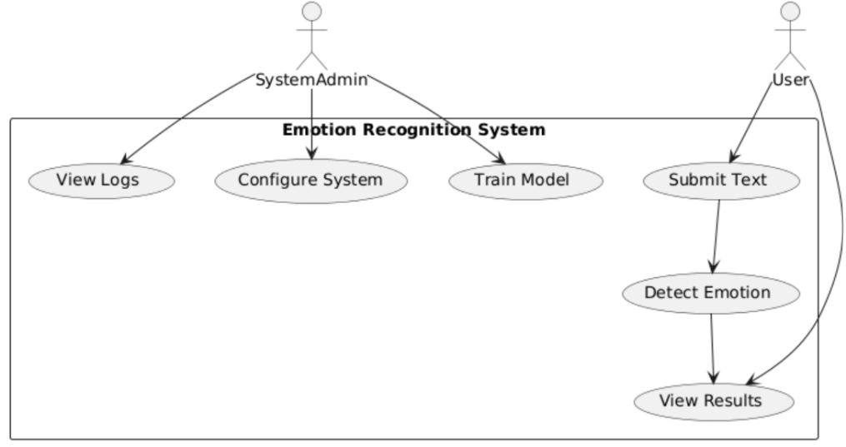
USE CASE DIAGRAM

Slide 9
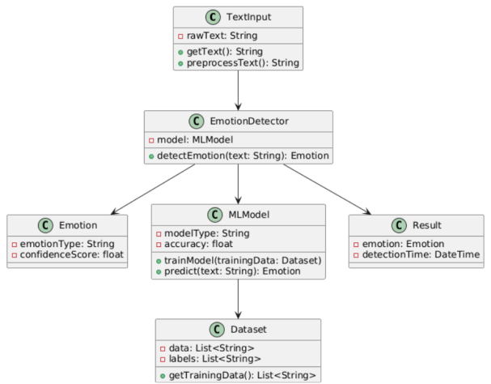
CLASS DIAGRAM

Slide 10
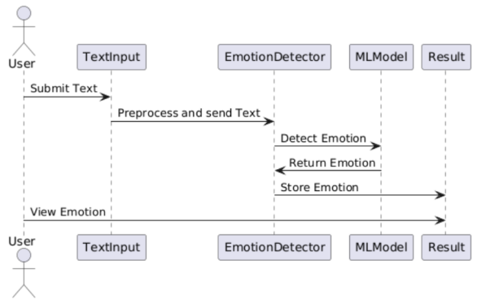
SEQUENCE DIAGRAM

Slide 11
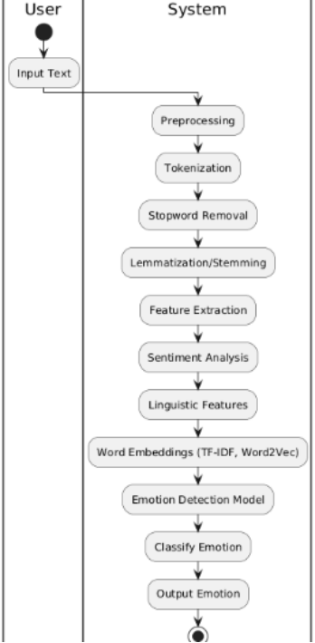
ACTIVITY DIAGRAM

Slide 12
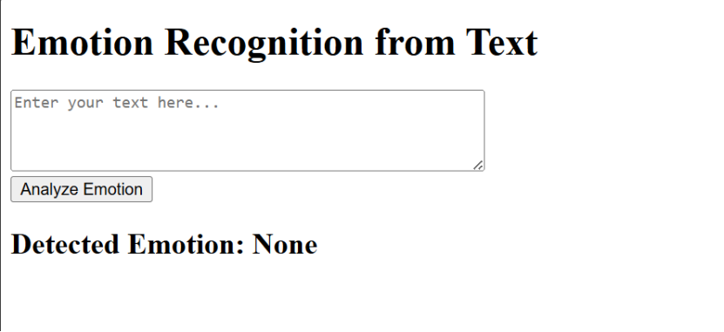
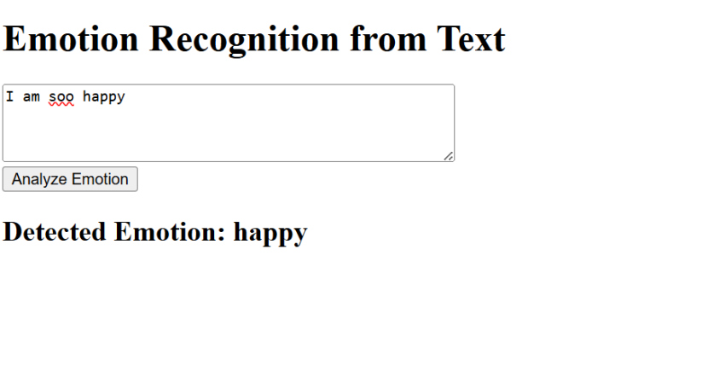
SCREENSHOTS

Slide 13
FUTURE ENCHANCEMENTS
The future enhancements for the emotion recognition project involve several important upgrades. Firstly, incorporating multi-language support and real-time feedback will enable the model to identify emotions in different languages and provide instant emotion detection as users type, boosting accessibility and engagement. Secondly, adding sentiment analysis will deliver deeper emotional insights, and allowing users to customize emotion categories will enhance the tool's flexibility and usability. Lastly, ensuring the application is mobile-friendly and developing visual displays of emotional trends over time will improve user experience, enabling individuals to effectively monitor and understand their emotional states better.

Slide 14
CONCLUSION
In summary, this project introduces a groundbreaking approach to emotion recognition from textual data, crucial for applications such as mental health monitoring and customer service. By combining advanced deep learning and natural language processing techniques with traditional feature extraction methods, the proposed hybrid model significantly enhances both accuracy and the detection of subtle emotional expressions across various contexts. The findings emphasize the importance of linguistic signals and contextual understanding in creating empathetic AI systems that can recognize emotions in real time. This advancement paves the way for more effective and responsive applications, ultimately improving user interactions and support in diverse fields.

Slide 15
Thank you

